Slide 1
Who and where did loans go during the pandemic?
Economic and business size disparity in accessing the paycheck protection plan.
Shakil Rafi, ASRI2022

Slide 2
TABLE OF CONTENTS
01
02
03
INTRODUCTION
MOTIVATION & HYPOTHESIS
DATA
04
05
06
THE EXPERIMENT
ANALYSIS
FUTURE WORK
What is PPP and why was it given
Why this hypothesis?
Data collection and exploratory data analysis
Statistical models used and their results
Does the results track with reality
Possible extensions

Slide 3
INTRODUCTION
What is the Paycheck Protection Plan and why was is created?

Slide 4
What is the PPP?
In 2020 during the pandemic, many businesses were shut-down resulting in loss of income.
The Paycheck Protection Program, PPP, was an approximately $900 billion dollar bill to help small businesses, and solo entrepreneurs to meet payroll.
And why was it given?

Slide 5
MOTIVATION AND HYPOTHESIS
Why are we doing, what we are trying to do?

Slide 6
Motivation & hypothesis
A body of literature already exists between race, gender of borrower against the size of the PPP loan.^{[1][2].} Besides the data is incomplete and has selection bias.
Not as much is known about the PPP against borrowers in poorer neighborhoods
Research on the access of small businesses have been categorical not quantitative
It is well known that poorer income neighborhoods tend have a hard time accessing sufficient credit lines ?^{[3]}
Is the story being repeated with the PPP?
Background to the hypothesis

Slide 7
“All else being equal, borrowers within a zip code with higher median income and businesses that are larger tend to be approved for higher initial PPP loans.

Slide 8
DATA CLEANING
MODEL TRAINING AND TESTING
PROCESS STEPS
EXPLORATORY DATA ANALYSIS
DATA COLLECTION
ANALYSIS AND INTERPRETATION

Slide 9
DATA
Collection, Cleaning and Exploratory Analysis

Slide 10
Data Sources
SBA Database
US Census Bureau & Kaggle
United States Office of Management and Budgeting
OpenStreetMap
Includes median income by zip code collated
Includes details about specific loans
Data visualization and EDA
NAICS code to business type

Slide 11
Where did the loans go?
SBA database consists of 11 million rows. Data was collated against zip code, whereas zip code was truncated after five digits.
Zip codes with median income of 0 were removed, as were zip codes with median income >300000.
We end up with ~24k zip codes
Computational resources means data can be shown only at a state level

Slide 12
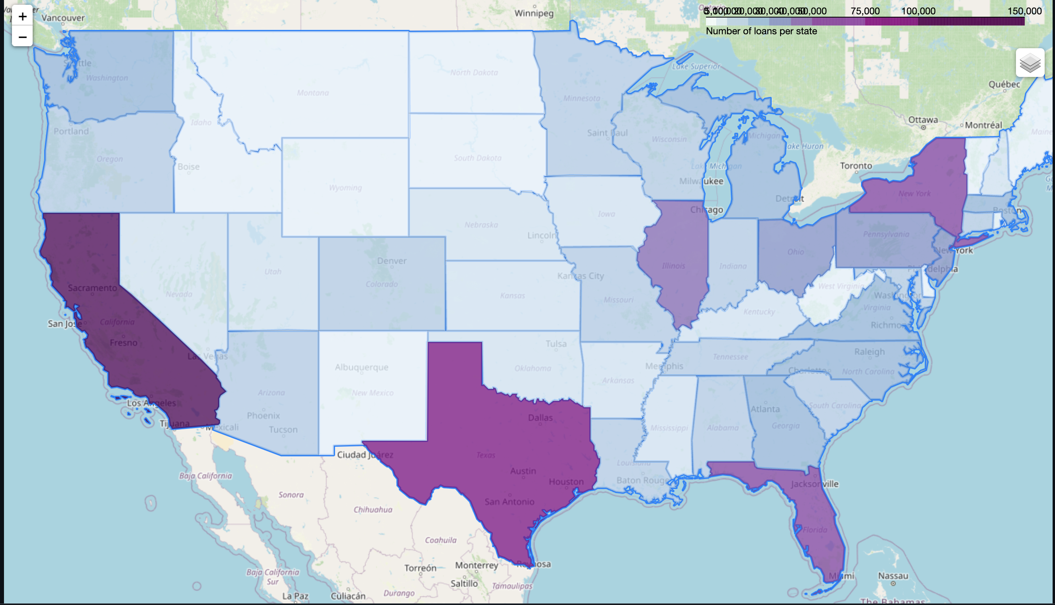
Where did the loans go?
Where there were most people

Slide 13
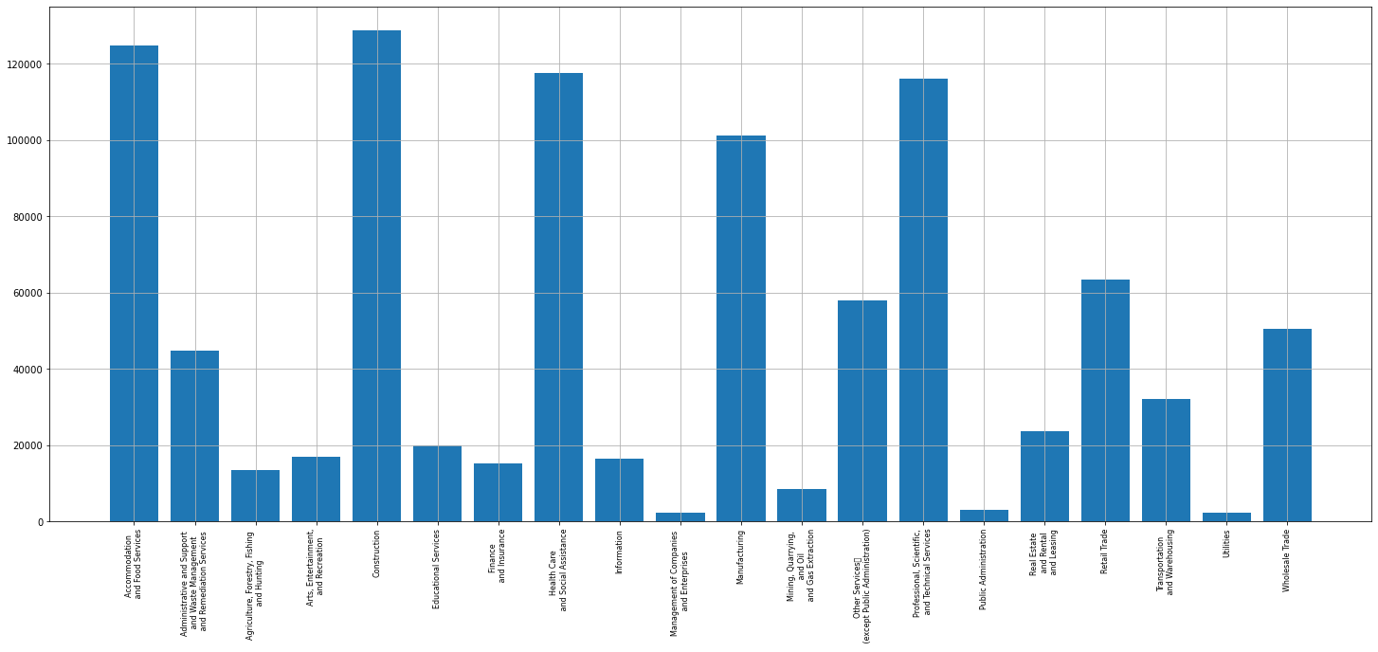
What industries received the most loans?

Slide 14
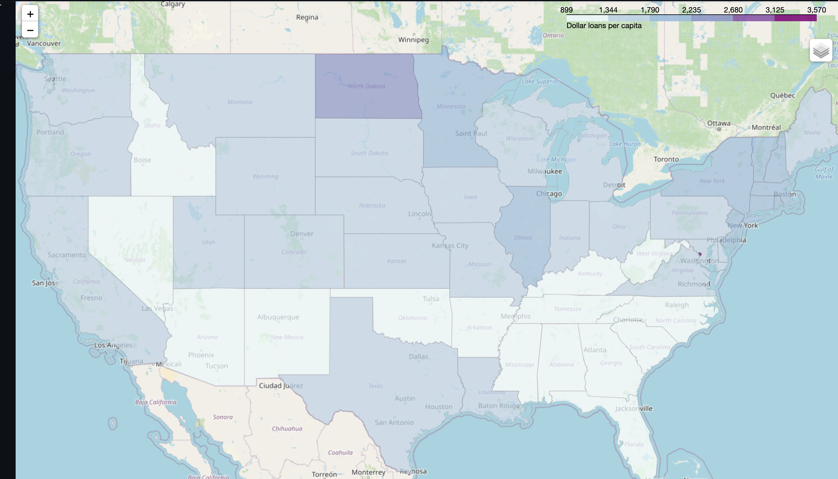
Did some states receive more than others?

Slide 15
THE EXPERIMENT

Slide 16
Methods
We take remove outliers from initial approval amounts (plus minus 2 sigma) and
We cap off median income per census tract at 200,000. This accounts for 95% of the data approx. 25k zip codes
We do a scatter plot.
We calculate correlation coefficient
We do a train, test split
We then train a simple linear regression model and calculate r squared.
We then train a decision tree regressor and calculate r squared.

Slide 17
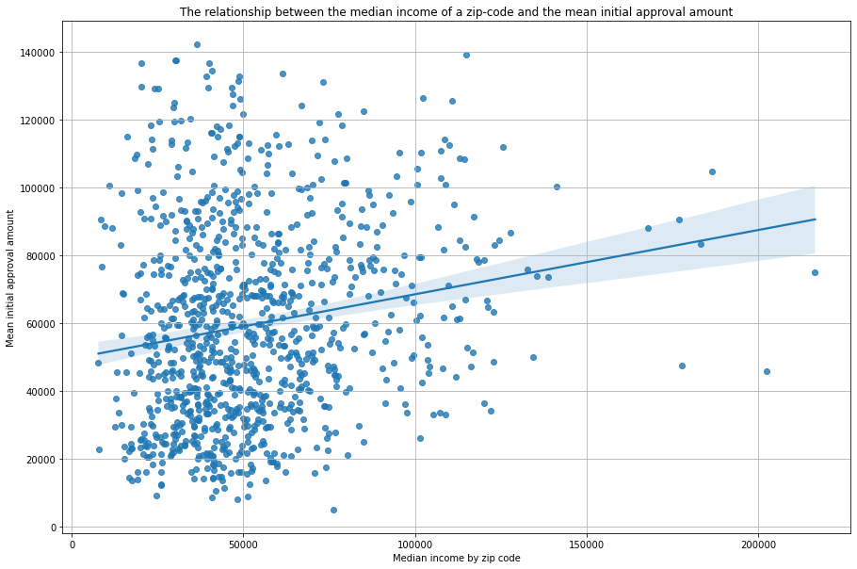
Scatter plot with confidence intervals

Slide 18
Vital Statistics: Linear Regression
R = 0.19
R2 score = 0.04
P < 0.0001
MAE = 23225
Rather strong correlation exists
Model has poor explanatory power
Statistically significant relation exists
After 10-fold cross validation

Slide 19
Vital Statistics: Tree Regressor
R = 0.19
R2 score = 0.05
P < 0.0001
MAPE = 0.55
Rather strong correlation exists
Model has poor explanatory power
Statistically significant relation exists
After one run.

Slide 20
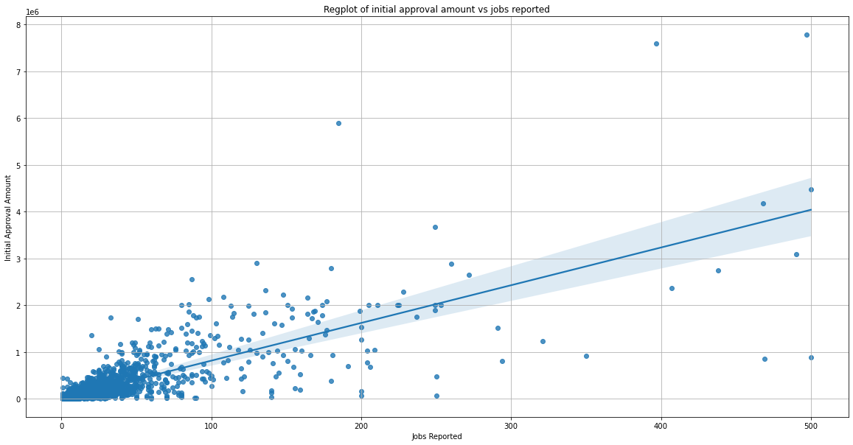
Scatter plot with confidence intervals

Slide 21
Vital Statistics: Linear Regression
R = 0.79
R2 score = 0.63
P < 0.0001
MAE = 36000
Rather strong correlation exists
Model has good explanatory power
Statistically significant relation exists
After 10-Fold cross-validation

Slide 22
Vital Statistics: Tree Regressor
R = 0.79
R2 score = 0.64
P < 0.0001
MAE = 38000
Rather strong correlation exists
Model has good explanatory power
Statistically significant relation exists
After 10-Fold cross-validation

Slide 23
ANALYSIS
Do the results make sense?

Slide 24
Analysis
The Federal Reserve Bank of Cleveland released adjacent data^{[4]}.
They showed that lower income neighborhoods (census tracts) tends to have fewer number of loans.
The results seen seem to create a story, but more research needs to be done.
It is also well known that lower income neighborhood residents tend to have a hard time accessing credit, and large amount of credit

Slide 25
Analysis
Large firms are able to justify the Initial Approval Amount due to their scale.
More likely to have specialized staff for applying for PPP.
It is also well known that lower income neighborhood residents tend to have a hard time accessing credit, and large amount of credit

Slide 26
Possible Issues
Instead of dropping zero median income data could be imputed.
More advanced regression techniques could be use. Author already used Polynomial Regression (with deg = 2).
More fine-grained analysis of individual states could be used.
Bivariate Moran’s I possible.

Slide 27
FUTURE WORK

Slide 28
Future Work
Why exactly is that North Dakota and D.C. have such high number of loans per capita?
What is the spatial lag between median income and initial approval amount?
Time-series analysis shows two batches in which PPP was given out. What is the qualitative relation between the two?

Slide 29
References
Atkins R., Cook L., Seamans R. Discrimination in lending? Evidence from the Paycheck Protection Program, Small Bus Econ (2022) 58:843–865
Demko I., Sant’Ana A., Impact of Race and Gender on the SBA Paycheck Protection Program (PPP) Loan Amounts. Available at SSRN: https://ssrn.com/abstract=3864218 or http://dx.doi.org/10.2139/ssrn.3864218
Kramer-Mills C., Landau R., Scally J. The State of Low-Income America: Credit Access & Debt Payment. Federal Reserve Bank of New York. 2020.
M. E. Schweitzer and G. Borawski, How Well Did PPP Loans Reach Low- and Moderate-Income Communities?, Economic Commentary, no. 2021–13, May 2021, doi: 10.26509/frbc-ec-202113.
Scikit-learn: Machine Learning in Python, Pedregosa et al., JMLR 12, pp. 2825-2830, 2011.
“NAICS Code Description,” NAICS Association. https://www.naics.com/naics-code-description/ (accessed Jun. 16, 2022).
“Median Personal, Family, and Household Income Data.” https://www.kaggle.com/census/median-personal,-family,-and-household-income-data (accessed Jun. 16, 2022).

